Slide 1
Introduction
Project Planning – Flowchart and NOOA-SDK
Download Weather Data from National Oceanic and Atmospheric Administration (NOAA)
Querying Database with SQL
Extract Data into Excel
Analyzed the Data
Produced Graphical Models and Interpretting Results

Slide 2
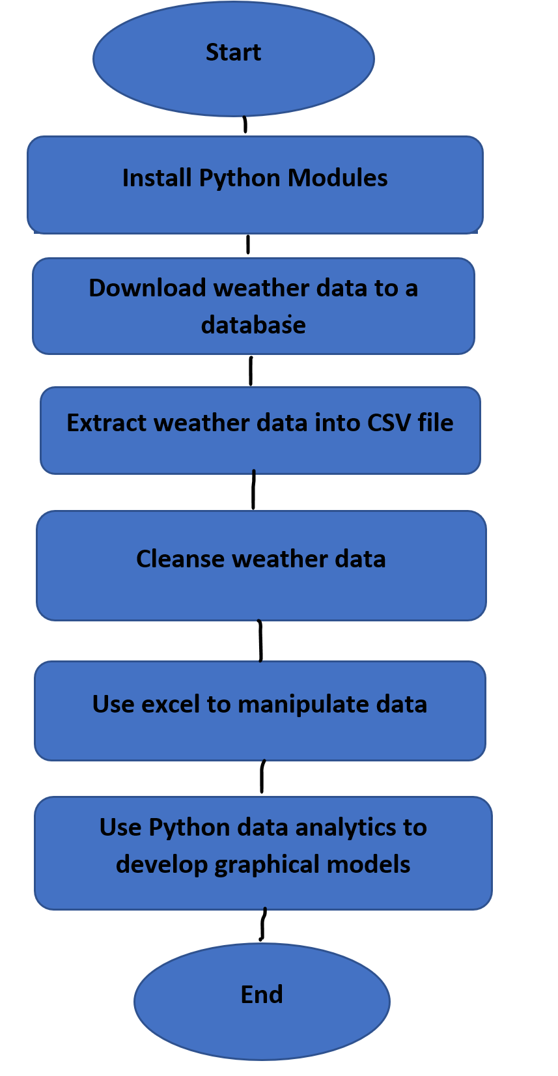
Flowchart
Install python
Download weather data to a database.
Extract weather data from database into a comma separated file with python
Cleanse weather data
Use Excel to manipulate data
Use python data analytics modules to develop graphical models

Slide 3
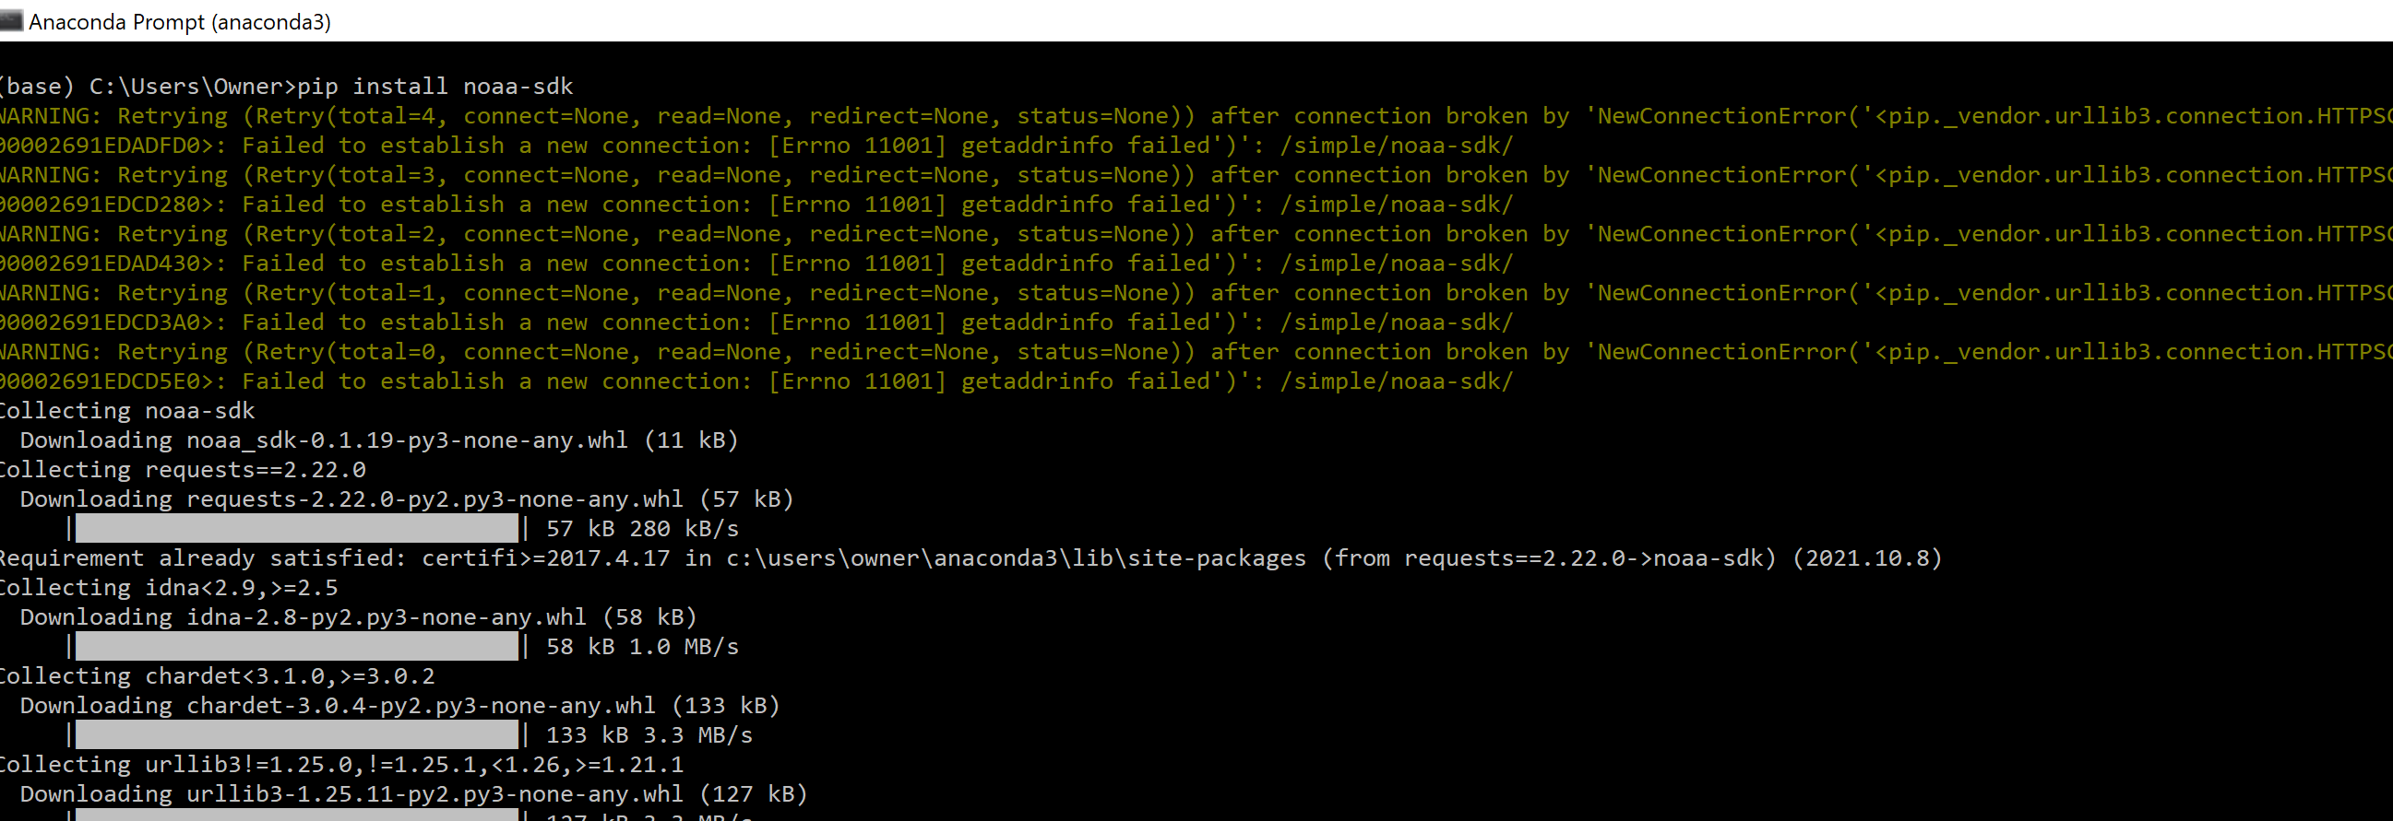
Software Inventory

Slide 4
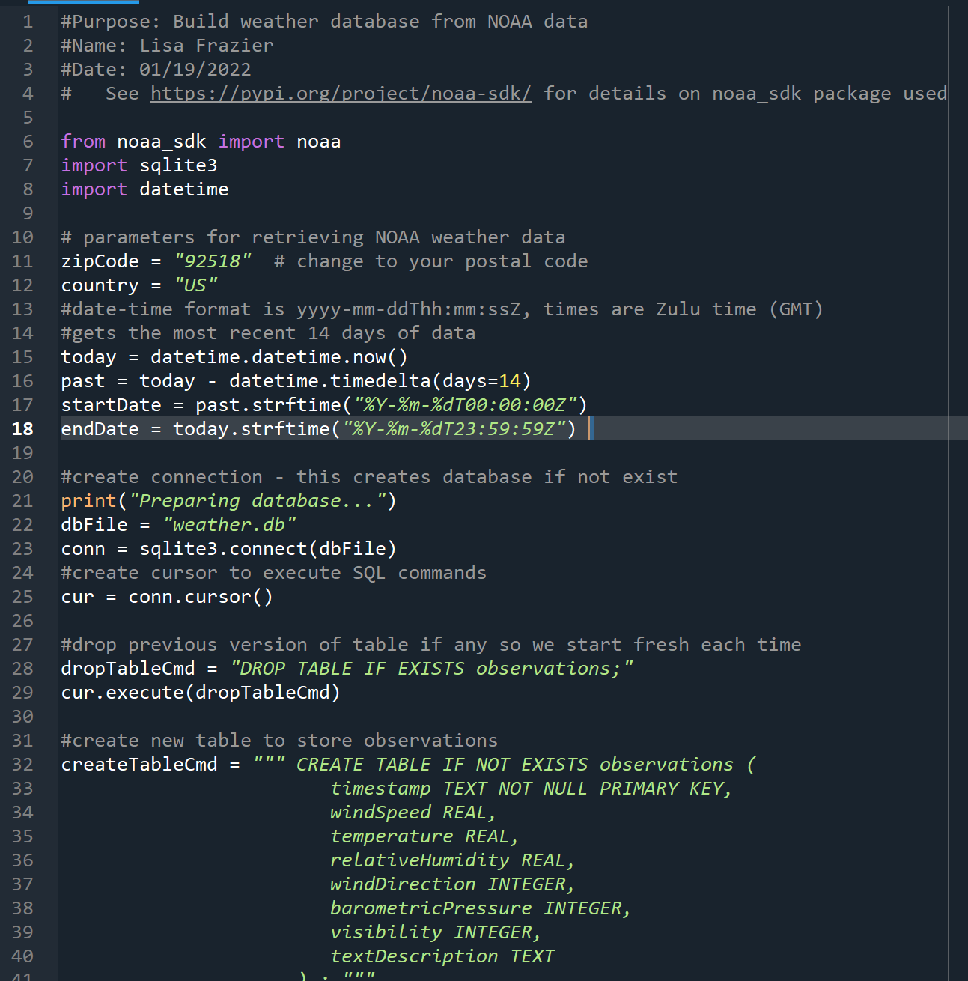
Python Console

Slide 5
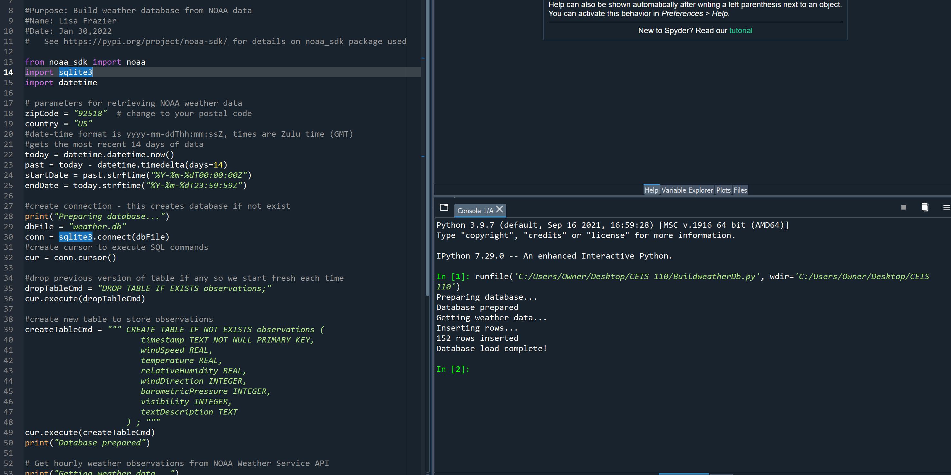
WeatherDb.py Code

Slide 6
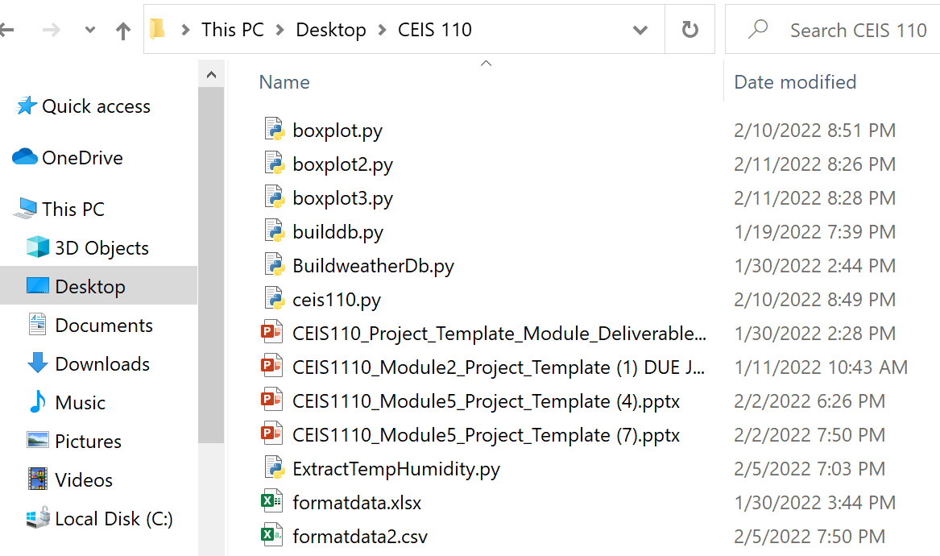
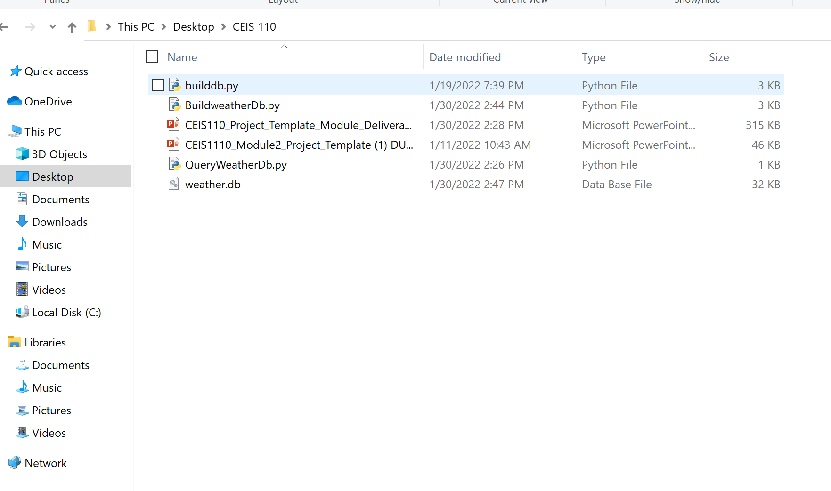
Weather.db File
(Screenshot)
Screenshot of Windows Explorer showing database file Weather.db was created

Slide 7
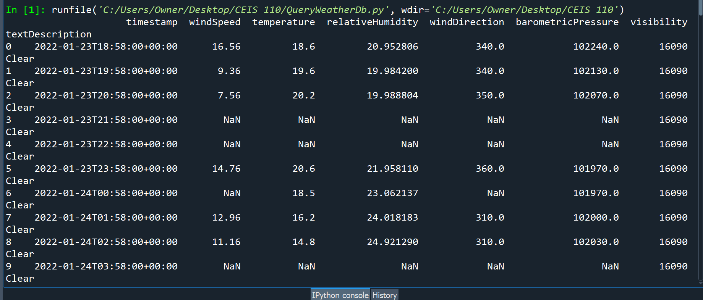
Query to retrieve all columns and all rows

Slide 8
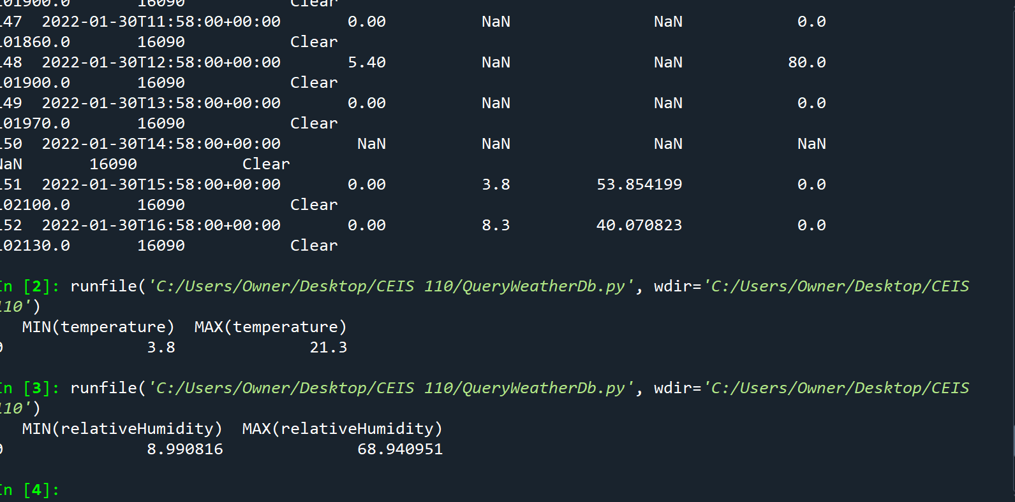
Query to retrieve lowest and highest temperatures

Slide 9
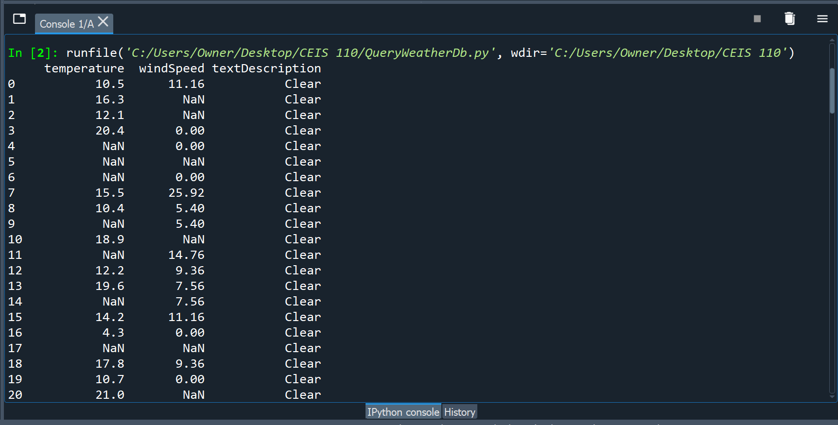
Query to retrieve all clear days

Slide 10
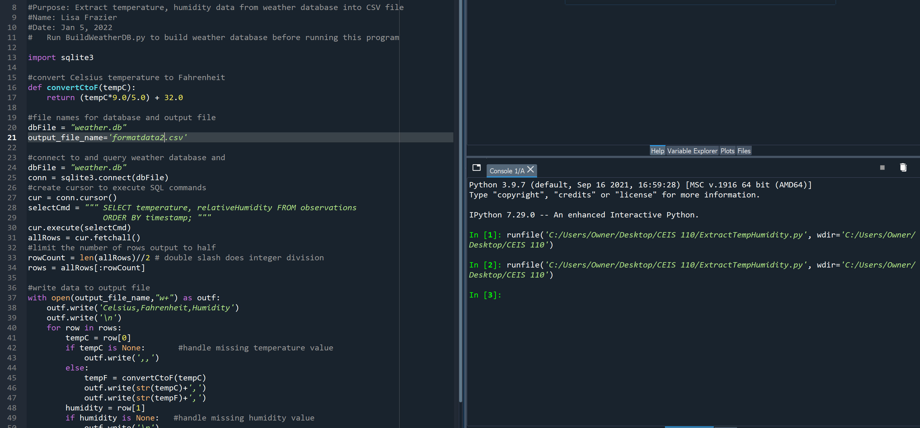
Python code

Slide 11
Retrieve and Convert Data to CSV Format
18.5 | 65.3 | 23.06214
16.2 | 61.16 | 24.01818
14.8 | 58.64 | 24.92129
10.7 | 51.26 | 34.10512
5.6 | 42.08 | 63.89882
10.4 | 50.72 | 51.03642
16.5 | 61.7 | 29.01692
18.8 | 65.84 | 21.00526
20.4 | 68.72 | 20.04013
21.3 | 70.34 | 18.96084
21.1 | 69.98 | 19.05233
17.8 | 64.04 | 32.98967
16.1 | 60.98 | 32.97133
4.5 | 40.1 | 67.98301
4.3 | 39.74 | 68.94095
4.2 | 39.56 | 68.91999
7.7 | 45.86 | 59.91232
12.2 | 53.96 | 47.98262
15.2 | 59.36 | 32.94846
17.4 | 63.32 | 28.01842
18.4 | 65.12 | 23.03511
20 | 68 | 19.93749
20.9 | 69.62 | 16.97542
21 | 69.8 | 18.05565
18.6 | 65.48 | 10.98545
10.8 | 51.44 | 24.94162
10.3 | 50.54 | 23.10779
6.3 | 43.34 | 30.07026
6.7 | 44.06 | 29.02419
12 | 53.6 | 20.97252
14.4 | 57.92 | 18.94501
16.6 | 61.88 | 18.06395
17.7 | 63.86 | 15.95815
18.5 | 65.3 | 12.96998
19.2 | 66.56 | 11.01572
19.5 | 67.1 | 11.99388
19.2 | 66.56 | 11.01572
18.3 | 64.94 | 13.02989
14.7 | 58.46 | 23.0705
11.4 | 52.52 | 20.9764

Slide 12
Temperature and Humidity Chart (Graph)

Slide 13
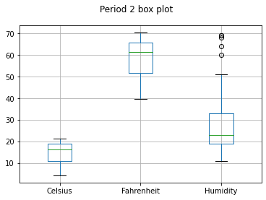
Plot # 1
Line Graph
#Purpose: Create box plot for period 2 data
#Name: Lisa Frazier
#Date: Feb 10, 2022
import pandas as pd
import matplotlib.pyplot as plt
df2 = pd.read_csv("formatdata2.csv")
df2.boxplot()
plt.suptitle('Period 2 box plot')
plt.show()

Slide 14
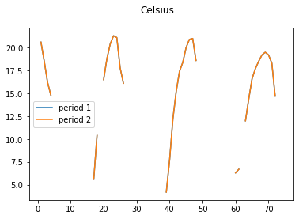
Plot #2
Histogram
#Purpose: Create Celsius plot comparing period 1 and period 2
#Name: Lisa Frazier
#Date: Feb 11, 2022
import pandas as pd
import matplotlib.pyplot as plt
df2 = pd.read_csv("formatdata2.csv") #data for period 2 (more recent)
plt.figure();
df2.Celsius.plot(label = 'period 1')
df2.Celsius.plot(label = 'period 2')
plt.legend(loc='best');
plt.suptitle('Celsius')
plt.show()

Slide 15
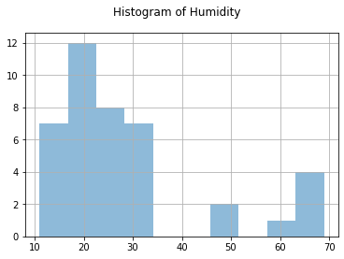
Analysis
#Purpose: Create a histogram of humidity data from the second period
#Name: Lisa Frazier
#Date: Feb 12,2022
import pandas as pd
import matplotlib.pyplot as plt
df2 = pd.read_csv("formatdata2.csv")
df2['Humidity'].hist(bins=10, alpha=0.5); plt.suptitle('Histogram of Humidity')
plt.show()
The breaks in this chart/graph are due to small zip code area
Weather has a break in sustainable variation
Based on the breaks supported by Chart: Histogram

Slide 16
Prediction
Based on the data I have; the weather is unpredictable. The variations in temperature and humidity is unexpected over the next few hours or days. I expect unpredictable humidity change if temperature goes up or down.

Slide 17
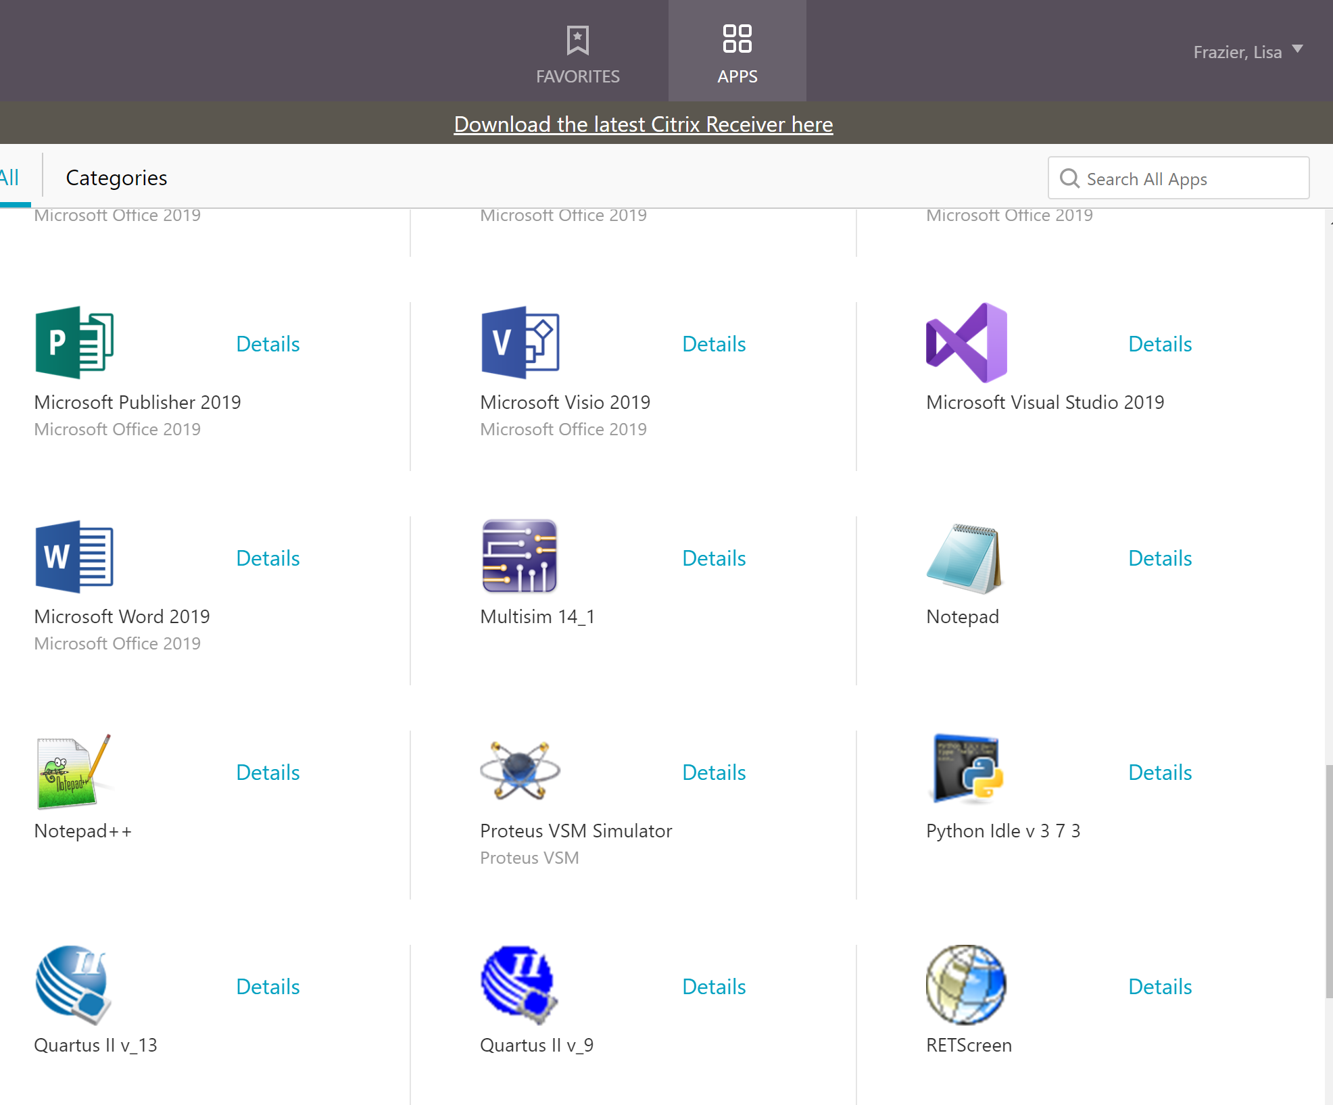
CHALLENGES
I had numerous challenges during week 5 to 8 as assignments got more complicating. However, my professor and tutors at DeVry University was extremely helpful in teaching me by Live Web links and Web Chats. Most of my confusion was with Syntax errors, Variant placements and understanding of questions asked before coding to make Python readable.

Slide 18


CAREER SKILLS
Python Programming
Reading Electronic System Design & Schematics
Adobe Creative Cloud, AHIMA, Cygwin, Code Warrior, FX Composer, Quartus Prime, Multisim, LuaPlus, FX Composer, FMOD Designer, DirectX, and DirectSoft.Measure

Slide 19
CONCLUSION
At DeVry University, I’ve learned to make use of analytical decisions taught to insure a readable programming. Below is a list of understanding and Interpreting bytes as packed binary data. This is where I got more of an understanding of Python Programming.
Syntax errors
Buffer protocols
Functions and Exceptions
Format Strings
Byte order, size and alignment
Classes
https://lfrazier18.wixsite.com/lisa-y-frazier
Source: https://docs.python.org/3/library/struct.html

